Slide 1



Cybersecurity in Emerging Technologies for the Energy Network
CSP007_C_E
Presentation by:

Slide 2


Slide 3


Cybersecurity in Emerging Technologies for the Energy Network – Course Overview
T3.
Securing the Energy Emerging Technologies
T4.
Data Analysis for Cybersecurity in the Energy Network

Slide 4

Training Outline
Topic-03 - Securing the Energy Emerging Technologies
Overview key points on securing IoE, cloud computing, blockchain, and AI.
The importance of implementing robust security measures.
Notes:
Welcome participants and briefly outline the importance of securing emerging technologies in the energy sector.

Slide 5

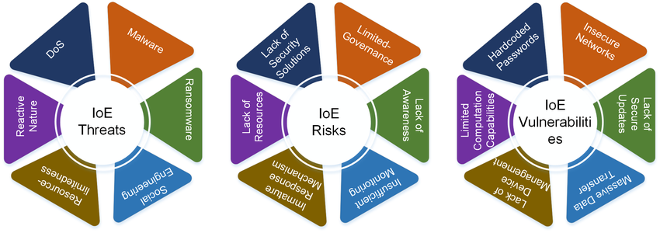
1. IoE Architecture and Vulnerabilities
Context
Overview of IoE (Internet of Energy):
  Network of interconnected devices, sensors, and systems within the energy grid.
Key Components:
  Smart meters, grid sensors, renewable energy sources, and control systems.
Common Vulnerabilities:
  Insecure communication protocols, outdated software, and weak authentication mechanisms.
Examples:
  Vulnerabilities in smart meters leading to unauthorized access.
  Source:https://www.researchgate.net/publication/364683506_Internet_of_Everything_Enabling_Technologies_Applications_Security_and_Challenges
Notes:
Explain the concept of IoE and its significance in modern energy systems.
Discuss the main components of IoE and how they interact.
Highlight common vulnerabilities and provide real-world examples to illustrate the risks.
IMAGE: https://www.researchgate.net/publication/364683506/figure/fig5/AS:11431281091923558@1666658865347/Taxonomy-of-IoE-threats-risks-and-vulnerabilities.ppm

Slide 6
2. Securing IoE Environments
Context
Best Practices for IoE Security:
  Implementing strong authentication and encryption methods.
  Regularly updating and patching IoE devices.
  Monitoring and logging network traffic for anomalies.
Examples of Security Measures:
  Using VPNs and secure communication protocols (e.g., TLS).
  Deploying intrusion detection systems (IDS) to monitor IoE networks.
Notes:
Discuss the best practices for securing IoE environments.
Provide examples of how these practices can be implemented effectively.
Emphasize the importance of regular updates and monitoring.

Slide 7
3. Cloud Security
Context
Cloud Security Models:
  Public, private, and hybrid cloud models.
  Shared responsibility model between cloud providers and users.
Cloud-Specific Threats:
  Data breaches, misconfigurations, insider threats, and DDoS attacks.
Mitigation Strategies:
  Implementing robust access controls and encryption.
  Regularly auditing cloud configurations and access logs.
Examples:
  Using Identity and Access Management (IAM) tools for better control.
  Employing Cloud Security Posture Management (CSPM) tools.
Notes:
Explain the different cloud security models and the shared responsibility model.
Discuss common cloud-specific threats and provide mitigation strategies.
Highlight the importance of access controls and regular audits.

Slide 8
4. Blockchain Security
Context
Security Properties of Blockchain:
  Decentralization, immutability, and transparency.
Vulnerabilities and Attack Vectors:
  51% attacks, smart contract vulnerabilities, and Sybil attacks.
Security Measures:
  Ensuring consensus integrity and smart contract security audits.
  Implementing multi-signature wallets and cold storage solutions.
Examples:
  Using formal verification methods for smart contract security.
  Implementing decentralized governance mechanisms.
Notes:
Describe the inherent security properties of blockchain technology.
Discuss common vulnerabilities and attack vectors.
Provide examples of security measures to protect blockchain systems.

Slide 9
5. AI Security
Context
Security Risks in AI:
  Bias in AI models, data privacy concerns, and adversarial attacks.
Methods for Securing AI:
  Ensuring data quality and diversity in training datasets.
  Implementing robust model evaluation and validation techniques.
  Employing adversarial training to improve model resilience.
Examples:
  Using differential privacy techniques to protect training data.
  Implementing secure AI pipelines for data processing and model deployment.
Notes:
Discuss the security risks associated with AI, including bias and adversarial attacks.
Explain methods for securing AI models and data.
Provide examples of techniques and best practices to enhance AI security.

Slide 10
6. Summary of Topic 3
Context
Recap of key points on securing IoE, cloud computing, blockchain, and AI.
Emphasize the importance of implementing robust security measures.
Prepare for the next topic: Data Analysis for Cybersecurity in the Energy Network.
Notes:
Summarize the main takeaways from this topic.
Highlight the critical role of security in emerging energy technologies.
Transition to the next topic on data analysis for cybersecurity.

Slide 11
Training Outline:
Topic-04 - Data Analysis for Cybersecurity in the Energy Network
Overview on data-driven cybersecurity and analysis techniques.
The Importance of using tools and methods for effective threat detection.
The Benefits of applying data analysis in the energy sector.
Notes:
Welcome participants and introduce the focus of the session on data analysis techniques for cybersecurity in the energy sector.

Slide 12
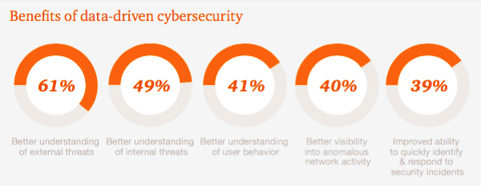
1. Importance of Data-Driven Cybersecurity
Context
Why Data Analysis is Crucial:
  Enables proactive threat detection and response.
  Provides actionable insights to improve security posture.
Types of Data Analyzed:
  Network traffic, system logs, user behavior, and anomaly detection.
Benefits:
  Early identification of potential threats.
  Improved decision-making based on data insights.
  Source: https://www.consultancy.uk/news/2884/pwc-uk-businesses-still-fail-to-take-on-cyber-security
Notes:
Discuss the importance of data-driven approaches in cybersecurity.
Highlight the types of data typically analyzed in energy networks.
Emphasize the benefits of leveraging data analysis for threat detection and response.
IMAGE: https://www.consultancy.uk/media/Benefits-of-data-driven-cyber-security-19208.jpg

Slide 13
2. Data Analysis Techniques
Context
Statistical Analysis:
  Using statistical methods to identify deviations from normal patterns.
  Examples: Mean, median, standard deviation, and outlier detection.
Machine Learning:
  Applying supervised and unsupervised learning for anomaly detection.
  Examples: Clustering, classification, and regression models.
Behavioral Analysis:
  Monitoring user and system behavior to identify unusual activities.
  Examples: Baseline behavior profiles, pattern recognition.
Notes:
Explain different data analysis techniques used in cybersecurity.
Provide examples of statistical methods and their applications.
Discuss the role of machine learning in detecting anomalies.
Highlight the importance of behavioral analysis in identifying threats.

Slide 14
3. Tools for Data Analysis
Context
Popular Data Analysis Tools:
  Splunk:
    Real-time data collection and analysis platform.
    Use cases: Log management, security information and event management (SIEM).
  ELK Stack (Elasticsearch, Logstash, Kibana):
    Open-source toolset for searching, analyzing, and visualizing log data.
    Use cases: Log analysis, real-time monitoring.
  Apache Hadoop:
    Framework for distributed storage and processing of large data sets.
    Use cases: Big data analytics, threat intelligence.
Features and Benefits:
  Scalability, real-time analysis, integration capabilities.
Examples:
  Demonstrate how these tools can be used in energy cybersecurity.
Notes:
Introduce popular tools used for data analysis in cybersecurity.
Discuss the features and benefits of each tool.
Provide examples of practical applications in the energy sector.

Slide 15
4. Applying Data Analysis in Energy Cybersecurity
Context
Use Cases:
  Network Traffic Analysis:
    Monitoring and analyzing network traffic for suspicious patterns.
    Example: Detecting DDoS attacks or unauthorized access attempts.
  Log Analysis:
    Analyzing system and application logs to identify anomalies.
    Example: Detecting unusual login patterns or system errors.
  User Behavior Analytics:
    Profiling normal user behavior and identifying deviations.
    Example: Detecting insider threats based on abnormal behavior.
Benefits:
  Enhanced threat detection and response capabilities.
  Improved security posture through continuous monitoring.
Notes:
Present real-world case studies of anomaly detection in the energy sector.
Case Study 1: Explain how anomaly detection can identify unauthorized access to SCADA systems.
Case Study 2: Describe how anomaly detection helps monitor smart grids for irregularities.
Case Study 3: Discuss the use of anomaly detection for predictive maintenance in energy equipment.
Emphasize the benefits of implementing anomaly detection systems.

Slide 16
5. Challenges in Data Analysis
Context
Data Volume and Velocity:
  Managing and processing large volumes of data in real-time.
Data Quality and Accuracy:
  Ensuring data is accurate, complete, and reliable.
Complexity of Analysis:
  Developing and maintaining sophisticated analytical models.
Integration with Existing Systems:
  Integrating data analysis tools with existing cybersecurity infrastructure.
Examples of Overcoming Challenges:
  Using data preprocessing techniques to improve data quality.
  Implementing scalable solutions for handling big data.
Notes:
Discuss the challenges faced in data analysis for cybersecurity.
Highlight the importance of data quality and managing data volume.
Provide examples of techniques to overcome these challenges.

Slide 17
6. Summary of Topic 4
Context
Recap of key points on data-driven cybersecurity and analysis techniques.
Importance of using tools and methods for effective threat detection.
Benefits of applying data analysis in the energy sector.
Introduction to the next topic on Security Tools and Techniques for Energy Emerging Technologies.
Notes:
Summarize the main takeaways from this topic.
Emphasize the critical role of data analysis in cybersecurity.
Transition to the next topic on specialized security tools and techniques.

Slide 18

Thank you
Please send all questions to:
gehad@example.com

