Slide 1



Cybersecurity in Emerging Technologies for the Energy Network
CSP007_C_E
Presentation by:

Slide 2


Slide 3


Cybersecurity in Emerging Technologies for the Energy Network – Course Overview
0.
Introduction & Course Context
1.
TOPIC 1 – Introduction to Cybersecurity in Energy Emerging Technologies
2.
TOPIC 2 – Anomaly Detection Techniques
3.
TOPIC 3 – Securing the Energy Emerging Technologies
4.
TOPIC 4 – Data Analysis for Cybersecurity in the Energy Network
5.
TOPIC 5 – Security Tools and Techniques for Energy Emerging Technologie
6.
The Future of Emerging Technology Security in Energy Networks

Slide 4

6. The Future of Emerging Technology Security in Energy Networks
Topic 6 Overview and Purpose
This topic explores:
How energy systems are evolving technologically
How cyber threats are evolving alongside them
Why future security must focus on resilience, anticipation, and preparedness
The goal is to move from reactive cybersecurity to strategic security thinking.
Notes:
Position Topic 6 as the capstone of the course.
Emphasise that this topic:
- Is less about specific tools
- More about mindset and strategy
Explain that future energy cybersecurity decisions will:
- Have long-term consequences
- Be made under uncertainty

Slide 5
6. The Future of Emerging Technology Security in Energy Networks
Evolution of Energy Systems
How Energy Systems Are Changing
Future energy systems are characterised by:
Increased digital control and automation
High penetration of renewable and distributed energy resources
Greater reliance on data, analytics, and AI
Tighter coupling with other sectors (mobility, smart cities, industry)
These changes fundamentally reshape the security landscape.
Notes:
Explain that energy systems are no longer isolated infrastructures.
Emphasise interdependencies:
- Power ↔ transport
- Power ↔ communication
Highlight that failures may cascade across sectors.

Slide 6
6. The Future of Emerging Technology Security in Energy Networks
Increasing Autonomy and AI Control
From Human-Controlled to Algorithm-Driven Systems
Energy systems increasingly rely on:
Automated control loops
AI-based optimisation and forecasting
Autonomous decision-making at the edge
This reduces reaction time but increases dependence on algorithmic correctness and integrity.
Notes:
Explain why autonomy is necessary (speed, complexity).
Emphasise new risks:
- Loss of human oversight
- Cascading algorithmic errors
Connect back to AI security topics from Topic 3.

Slide 7
6. The Future of Emerging Technology Security in Energy Networks
Decentralisation and Prosumers
A More Distributed and Participatory Grid
Modern energy systems include:
Millions of small producers (solar, storage)
Prosumers acting as consumers and suppliers
Peer-to-peer and local energy markets
Decentralisation expands the attack surface and complicates governance.
Notes:
Explain why decentralisation is good for resilience and risky for security.
Highlight:
- Heterogeneous ownership
- Uneven security maturity
Emphasise coordination challenges.

Slide 8
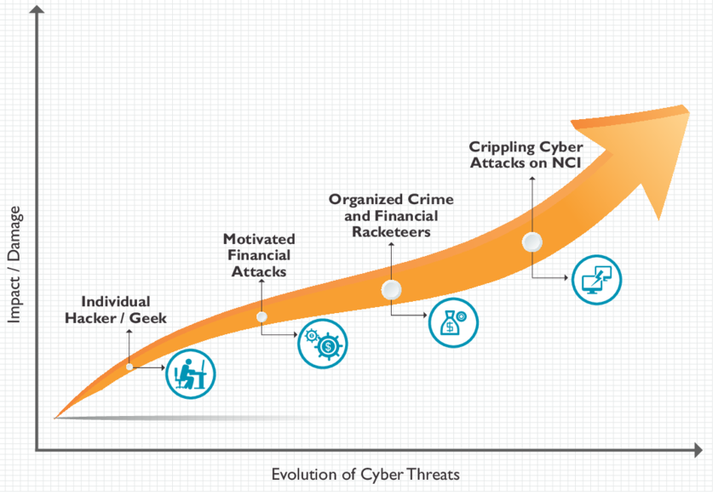
6. The Future of Emerging Technology Security in Energy Networks
Emerging Cyber Threat Landscape
How Threats Are Evolving
Future cyber threats are expected to be:
More stealthy and persistent
Better coordinated and multi-stage
Targeted at systemic weaknesses rather than single assets
Attackers increasingly exploit complexity and interdependence.
Notes:
Emphasise that future attacks may not look like “attacks”.
Explain slow-burn, low-noise strategies.
Connect to anomaly detection and correlation needs.

Slide 9
6. The Future of Emerging Technology Security in Energy Networks
AI-Powered and Automated Attacks
Attackers Also Use AI
AI can be used by attackers to:
Automate reconnaissance and exploitation
Adapt attacks dynamically
Generate convincing phishing and social engineering
This creates an arms race between defenders and attackers.
Notes:
Emphasise symmetry: defenders are not the only ones using AI.
Explain why automation increases attack speed and scale.
Highlight the need for AI-aware defence strategies.

Slide 10
6. The Future of Emerging Technology Security in Energy Networks
Supply Chain and Third-Party Risks
Security Beyond Organisational Boundaries
Energy systems depend on:
Hardware vendors
Software suppliers
Cloud and service providers
A single compromised supplier can affect many organisations simultaneously.
Notes:
Explain why supply-chain attacks are difficult to detect.
Emphasise long trust chains.
Connect to procurement and governance decisions.

Slide 11
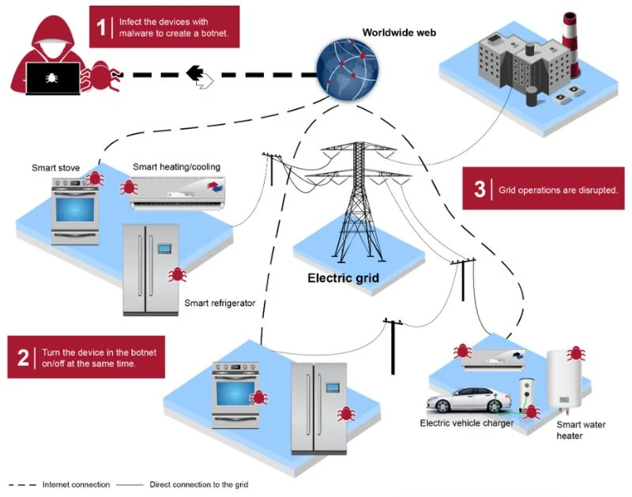
6. The Future of Emerging Technology Security in Energy Networks
Cyber-Physical Attack Convergence
When Cyber Attacks Cause Physical Impact
Cyber-physical attacks can:
Disrupt power supply
Damage equipment
Endanger human safety
Future attacks will increasingly blur the line between cyber and physical domains.
Notes:
Stress that energy cybersecurity is inseparable from safety.
Explain why impact assessment must consider physical consequences.
Avoid sensationalism; focus on risk reasoning.

Slide 12
6. The Future of Emerging Technology Security in Energy Networks
From Perimeter Security to Zero Trust
Why Traditional Security Models Fail
Classic perimeter-based security assumes:
Clear inside vs outside
Trusted internal networks
Modern energy systems require:
Continuous verification
Strong identity everywhere
Minimal implicit trust
This shift is captured by Zero Trust principles.
Notes:
Explain why perimeters dissolve in distributed systems.
Emphasise identity-centric security.
Avoid deep architectural detail; focus on philosophy.

Slide 13
6. The Future of Emerging Technology Security in Energy Networks
Resilience and Fault Tolerance
Security Is Also About Recovery
Future security strategies prioritise:
Absorbing attacks without collapse
Maintaining essential functions
Rapid and safe recovery
Resilience accepts that some failures are inevitable.
Notes:
Explain difference between prevention and resilience.
Use analogies (engineering fault tolerance).
Stress importance for critical infrastructure.

Slide 14
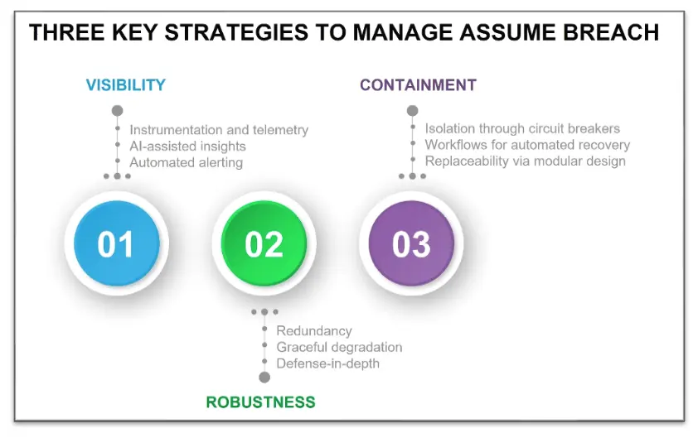
6. The Future of Emerging Technology Security in Energy Networks
The Assume-Breach Mindset
Planning for Failure, Not Perfection
Assume-breach means:
Accepting that defences can fail
Designing systems to limit damage
Detecting and responding quickly
This mindset leads to more realistic security architectures.
Notes:
Emphasise psychological shift.
Explain why optimism bias is dangerous.
Connect to layered defence and monitoring.

Slide 15
6. The Future of Emerging Technology Security in Energy Networks
Human and Organisational Factors
People Remain Central to Security
Future energy cybersecurity depends on:
Skilled professionals
Clear roles and responsibilities
Effective communication under stress
Organisational security culture
Technology cannot compensate for weak governance.
Notes:
Stress human decision-making under pressure.
Emphasise training and exercises.
Connect to ethics and accountability.

Slide 16
6. The Future of Emerging Technology Security in Energy Networks
Skills, Training, and Governance
Preparing Organisations for the Future
Key requirements include:
Continuous skills development
Cross-disciplinary expertise (energy + cyber)Clear governance and escalation paths
Security maturity is organisational, not purely technical.
Notes:
Emphasise long-term investment in people.
Explain governance as an enabler, not bureaucracy.
Connect to ECSF relevance.

Slide 17
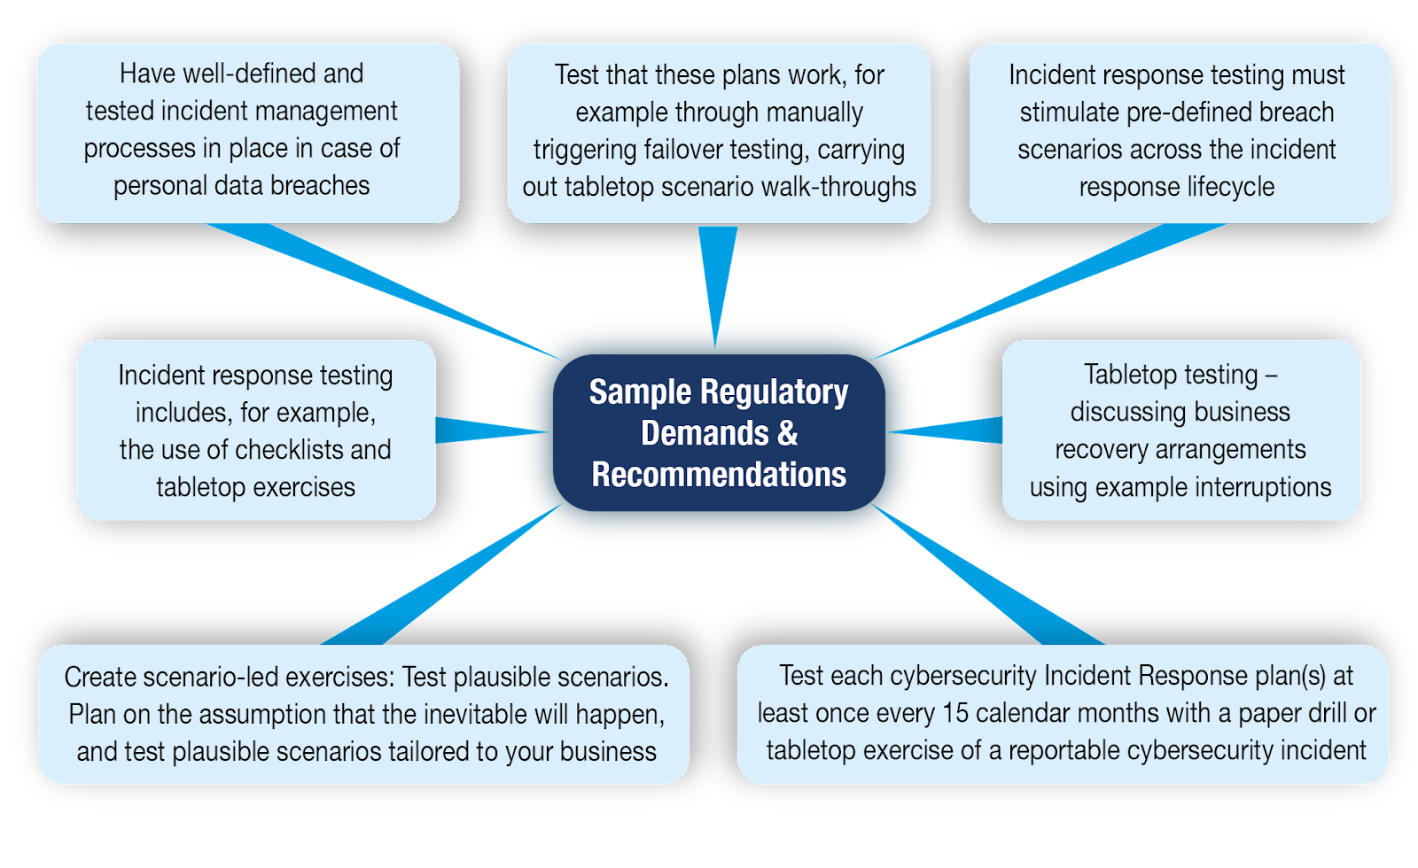
6. The Future of Emerging Technology Security in Energy Networks
Preparedness and Cyber Exercises
Practising for Real Incidents
Preparedness activities include:
Table-top exercises
Technical simulations
Cross-organisational drills
Exercises reveal weaknesses before attackers do.
Notes:
Emphasise learning value over blame.
Explain why exercises improve coordination.
Connect to incident response readiness.

Slide 18
6. The Future of Emerging Technology Security in Energy Networks
Research, Regulation, and Innovation
Shaping the Future Security Landscape
Future security depends on:
Applied research and pilot projects
Regulation that evolves with technology
Collaboration between academia, industry, and policymakers
Innovation must be security-aware by design.
Notes:
Explain that regulation often lags technology.
Emphasise role of research projects and testbeds.
Encourage proactive security-by-design.

Slide 19
6. The Future of Emerging Technology Security in Energy Networks
Course-Wide Synthesis
Connecting All Topics
Throughout the course, we have seen that:
Detection, protection, data, tools, and strategy are interdependent
Energy cybersecurity is cyber-physical and socio-technical
Security decisions involve trade-offs, not absolutes
Notes:
Help students see the big picture.
Encourage reflection:
Which risks are technical?
Which are organisational?

Slide 20
6. The Future of Emerging Technology Security in Energy Networks
Final Wrap-Up and Discussion
Final Thoughts
Energy cybersecurity is not about:
Eliminating all risk
It is about:
Understanding systems
Managing uncertainty
Building resilient and trustworthy energy infrastructures
Discussion
What do you see as the biggest future security challenge?
Notes:
End on an open, reflective note.
Encourage discussion and critical thinking.
Reinforce the course’s central message:
- “Good cybersecurity enables the energy transition.”

Slide 21

Thank you

