Slide 1


Topic-3: Anomaly Detection in the Health Sector
CSP007_S_H
PRESENTATION BY:
Danijela Boberic Kraticev (UNSPMF)

Slide 2


Slide 3
Importance of Network Security in Healthcare
Healthcare organizations are prime targets for cyberattacks due to the valuable data they hold.
Ensuring robust network security is vital to protect patient information, maintain trust, and comply with regulations.
Some statistics:
66% of Healthcare Organizations Say Patient Care was Disrupted by a Cyberattack
Healthcare sector suffers the highest costs for data breaches - almost $2 million more than the average cost across all sectors
Patient medical records are sold for roughly $250 on the black market, making them a lucrative target.
The average time to detect a healthcare data breach is over 200 days.
Notes:
https://www.hipaajournal.com/healthcare-data-breach-statistics/

Slide 4
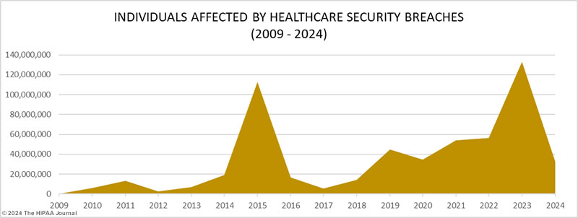
Healthcare Data Breach Statistics
Notes:
https://www.hipaajournal.com/healthcare-data-breach-statistics/

Slide 5
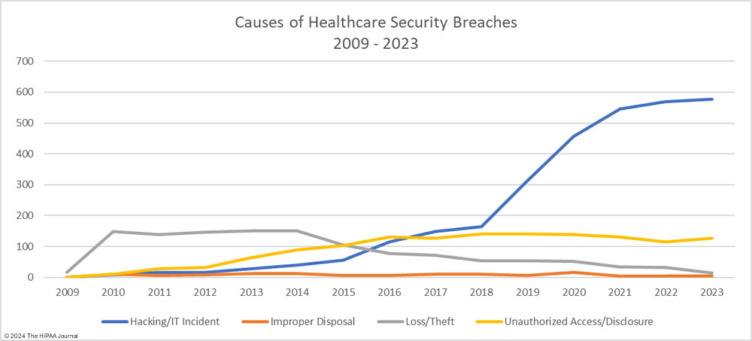
Causes of Healthcare Data Breaches

Slide 6
Cyberattacks on healthcare organizations
WannaCry Ransomware Attack (2017)
National Health Service across England and Scotland have been hit
up to 70,000 devices – including computers, MRI scanners, blood-storage refrigerators and theatre equipment have been affected
Universal Health Services Ransomware Attack (2020)
UHS facilities across the US had to shut down their IT systems to prevent the spread of the ransomware
Singapore Health Services (SingHealth) Data Breach (2018)
Personal data of 1.5 million patients was compromised
The stolen data included names, addresses, dates of birth, and details of outpatient visits

Slide 7
Internet of Medical Things
Internet of Medical Things (IoMT) encompasses the full range of connected healthcare infrastructure and medical devices, enterprise hardware, and software applications designed for linking healthcare information technology.
Healthcare IoT devices are commonly used for patient diagnostics, monitoring, and care
Securing healthcare Internet of Things (IoT) devices is crucial to protect sensitive patient data and ensure the integrity of medical systems.

Slide 8
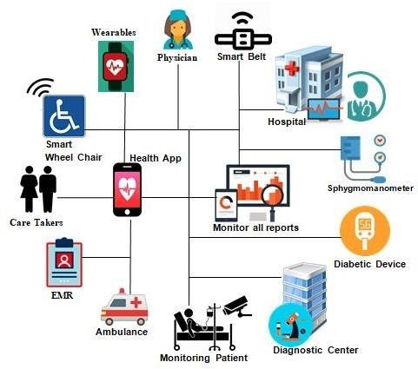
Key Components of IoMT
Wearable Devices: Health monitors, fitness trackers, and smartwatches that track vital signs, activity levels, and other health metrics.
Implantable Devices: Pacemakers, insulin pumps, and other devices that are implanted in patients to monitor and manage medical conditions.
Medical Equipment: Hospital equipment such as MRI machines, ventilators, and infusion pumps that are connected to networks.
Remote Patient Monitoring Systems: Systems that allow healthcare providers to monitor patients remotely, often in their homes.
Health Information Systems: Electronic health records (EHRs), hospital information systems, and other software that store and manage patient data.

Slide 9
Cybersecurity Challenges in IoMT
IoMT devices collect sensitive health data that must be protected to maintain patient privacy.
IoMT devices often have limited computing power and storage, making it difficult to implement robust security measures.
Ensuring secure communication and data exchange between IoMT devices and legacy healthcare systems may be challenging
Regularly updating the firmware and software of IoMT devices to patch vulnerabilities may be challenging
IoMT devices must comply with healthcare regulations such as HIPAA (Health Insurance Portability and Accountability Act) in the US and GDPR (General Data Protection Regulation) in the EU.

Slide 10

Thank you
Please send all questions to:
dboberic@uns.ac.rs

