Slide 1


Topic-2:Machine learning algorithms for anomaly detection
CSP007_S_H
PRESENTATION BY:
Danijela Boberic Kraticev (UNSPMF)

Slide 2


Slide 3
Introduction to Machine Learning
Machine learning is the process of teaching a model how to perform a task by providing it with data.
Instead of explicitly coding the model to do the task, we program the mechanisms by which this model can learn, improve, and repeat the task so that by the end of training, the model is able to perform whatever task we want it to.
Model is an advanced function that takes the input data and maps it to a specific output.
When a model is learning, it is adjusting its internal mechanisms to better perform the task on the data it is given.

Slide 4
Steps in applying machine learning (½)
Problem statement: What is the task you are trying to solve?
Data collection: You first need the relevant data before you can teach the model anything.
Data processing: Processing the data and manually annotating (if necessary) to show the model what correct performance on the task looks like. This is where you clean the data, analyze it, and perform feature engineering.
Data splitting: Partitioning the dataset into training, testing, and validation components. The idea is to train on the training split, evaluate on the testing split, and make improvements using the validation split.

Slide 5
Steps in applying machine learning (2/2)
5. Model training: Training the model on the training dataset.
6. Model evaluation: Evaluating your model’s performance on testing data and examining any faults with the process so far. The blind performance (testing data is unseen by the model) can indicate a lot about the effectiveness of the model.
7. Model tuning: Optimizing the performance by tuning certain high-level parameters that can affect the learning ability of the model.

Slide 6
Types of machine learning
Supervised learning
  Classification
  Regression
Unsupervised learning
  Clustering
  Representation learning/dimensionality reduction
Semi-supervised learning
  Teacher-student model
  Training on one class

Slide 7
Evaluation of model
Error is a measure of how wrong the model’s predictions are. Error is also commonly referred to as the loss of a model.
The objective for any learning task is to minimize the loss
Different types of machine learning may have different functions to calculate error
Classification - > Binary Cross-Entropy Loss (Log Loss), Categorical Cross-Entropy Loss
Regression - > Mean Squared Error (MSE)
Clustering -> Silhouette Score

Slide 8
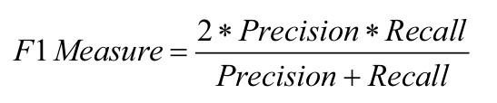
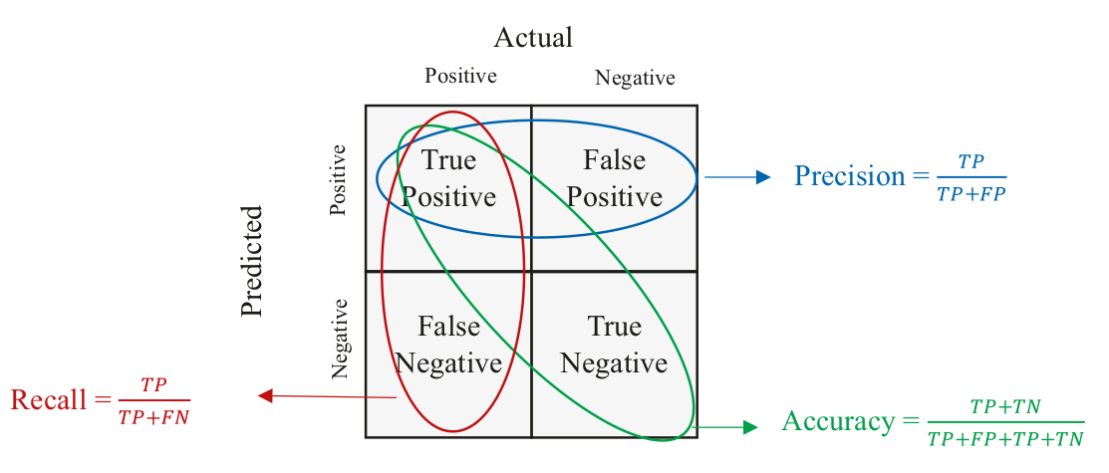
Classification Metrics

Slide 9
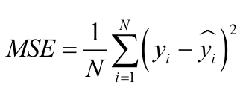
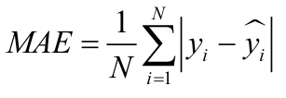
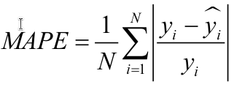
Regression Metrics
Mean-squared error (MSE) measures the average squared deviance of prediction and true value
Mean absolute error (MAE) measures the average magnitude of deviance of prediction and true value
Mean absolute percentage error (MAPE) measures percentage deviations of the prediction from the true value.
Notes:
Mean-squared error penalizes larger deviations more than smaller ones because of the squared element
Mean absolute error penalizes all the values much more equally. Larger deviations won’t incur as high an error as they would with MSE. This is more useful when prioritizing the bulk of the predictions over outliers.

Slide 10
Overfitting and Bias-Variance Tradeoff (1/2)
Bias refers to the error introduced by approximating a real-world problem with a simpler model. High bias models may underfit the training data.
Variance refers to the model's sensitivity to small fluctuations in the training data. High variance models may overfit the training data. The goal is to find the right balance between bias and variance to minimize the model's total error on unseen data.
Overfitting occurs when a machine learning model learns the training data too well, capturing noise or random fluctuations in the data rather than the underlying pattern. An overfitted model performs well on the training data but poorly on unseen or test data.
Notes:
Bias refers to the error of the machine learning model on the training set. It is a measure of how well the machine learning model correctly predicts the y-values in the training set. Low bias implies low training error (and thus good fit), while high bias implies high training error (and thus a poor fit).
Variance refers to the error in predictions on test data. High variance means noisy and unstable predictions that will incur a high test loss, implying poor generalization. Low variance means stable and consistent predictions, leading to a lower test loss (provided the model is not too biased).

Slide 11
Overfitting and Bias-Variance Tradeoff (2/2)
Overfitting is influenced by a few parameters:
Model complexity
Training time
Insufficient training data
Poor data processing
Ways to avoid overfitting:
Regularization
Reduce complexity
Hyperparameter tuning

Slide 12
Hyperparameter Tuning
Hyperparameter tuning is the process of selecting the optimal hyperparameters for a machine learning model to achieve better performance on unseen data.
Hyperparameters are configuration settings that are external to the model and cannot be directly learned from the data during training
Techniques for hyperparameter tuning:
Manual search
Grid search
Bayesian optimization
Gradient-based Optimization

Slide 13
Machine learning for anomaly detection
Machine learning provides several techniques to effectively perform anomaly detection:
Clustering: These methods group similar data points together, and points that do not fit well into any cluster are considered anomalies.
Autoencoders: Neural networks that learn a compressed representation of data and can identify anomalies by reconstruction error.
One-Class SVM: Trains on normal data to define a boundary around it, and points outside this boundary are considered anomalies.
Isolation forests exploit a decision tree-like architecture to uncover anomalies, assuming that those anomalies would be most easily split from the rest of the data (and thus closer to the root of the decision tree)
Local outlier factor is a common density-based unsupervised learning method, which identifies anomalies as points which have significantly lower density than neighboring observations
…

Slide 14
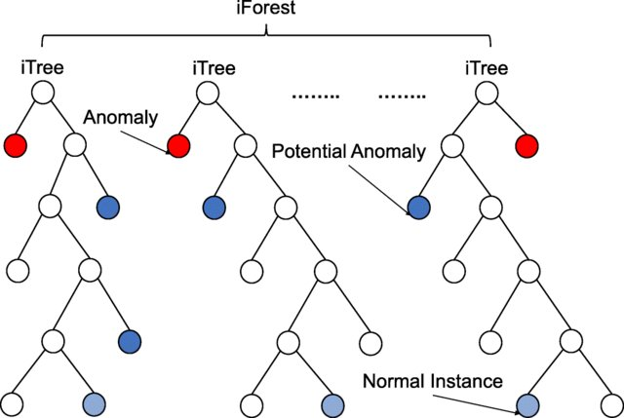
Anomaly Detection with an Isolation Forest
Isolation Forest is an anomaly detection algorithm that is based on the concept of isolating anomalies instead of profiling normal data points.
It is unsupervised ML algorithm which detects anomalies using binary trees.
The algorithm has a linear time complexity and a low memory requirement, which works well with high-volume data.

Slide 15
Anomaly Detection with an Isolation Forest
Steps in the algorithm:
Random Partitioning: The algorithm randomly selects a feature and then randomly selects a split value between the minimum and maximum values of the selected feature. This process is repeated recursively until each data point is isolated into its own partition.
Isolation: Anomalies are expected to be easier to isolate because they require fewer splits to separate them from the rest of the data points, compared to normal data points. Therefore, anomalies should end up in shorter paths in the tree structure.
Scoring: The algorithm assigns an anomaly score to each data point based on the average path length required to isolate the data point across multiple trees. Data points with shorter average path lengths are considered to be anomalies, while data points with longer average path lengths are considered to be normal.

Slide 16
Anomaly Detection with an Isolation Forest
Advantages:
working well with high-dimensional data
scalability
providing explanation why data point is anomaly (anomaly scoring)
Disadvantages:
sensitive to hyperparameters
sensitive to dense data
sensitive to imbalanced dataset (the parameter contamination must be set to help the Isolation Forest understand how many anomalies to expect)

Slide 17
Anomaly Detection with an Isolation Forest
Example of implementation of Isolation Forest in Python
https://colab.research.google.com/drive/1vvMNB08VhdqAMrwIcnt-TgSodfK4YpGa?usp=sharing
Dataset:
KDDCUP 1999 dataset, which contains an extensive amount of data representing a wide range of intrusion attacks.
https://kdd.ics.uci.edu/databases/kddcup99/kddcup99.html
We will narrow the scope to only data related to HTTP attacks

Slide 18
Anomaly Detection with OC-SVM
The One Class Support Vector Machine (OC-SVM) is a modified support vector machine model that is well-suited for novelty detection
It is an example of unsupervised and semi-supervised anomaly detection algorithm
The idea is that the model trains on normal data and is used to detect anomalies when new data is presented to it.
It's based on the idea of finding a hyperplane (or hypersphere in higher dimensions) that separates the normal data points from the outliers in the feature space.

Slide 19
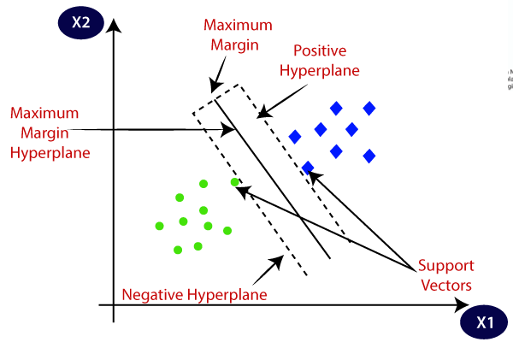
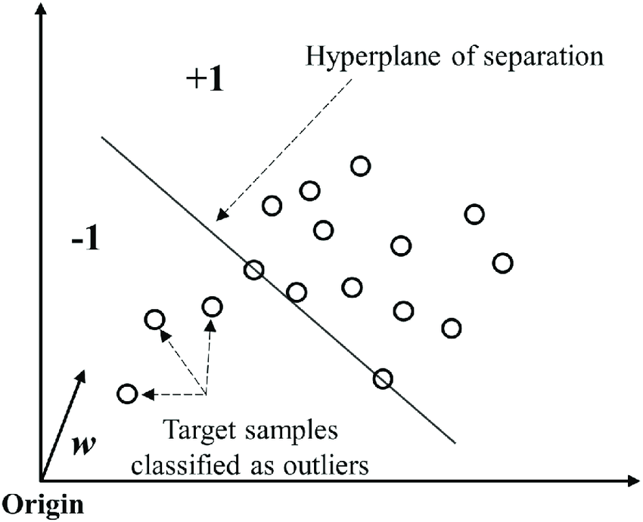
Anomaly Detection with OC-SVM
One-class SVM is a variation of the SVM
SVM for classification finds a max-margin hyperplane that separates the positive examples from the negative ones.
The one-class SVM finds a hyperplane that separates the given dataset from the **origin** such that the hyperplane is as close to the data points as possible.
Usually the RBF kernel is used to fit a non-linear boundary around the dense region of the dataset separating the remaining points as outliers
SVM
OC-SVM

Slide 20
Anomaly Detection with OC-SVM
Advantages:
able to handle higher-dimensional data due to its use of the kernel trick
can be trained in an unsupervised and semi-supervised manner
can model nonlinear decision boundaries
Disadvantages:
sensitive to hyperparameters
sensitive to noisy data
scales quite poorly as the data size increases

Slide 21
Anomaly Detection with OC-SVM
Example of implementation of OC-SVM in Python
https://colab.research.google.com/drive/1BCTJdaStef7ymktw1FmzR-1kQwpcPQ3B?usp=sharing
Dataset:
KDDCUP 1999 dataset, which contains an extensive amount of data representing a wide range of intrusion attacks.
https://kdd.ics.uci.edu/databases/kddcup99/kddcup99.html
We will narrow the scope to only data related to HTTP attacks

Slide 22
Anomaly Detection with autoencoders
Autoencoders are a type of neural network used for unsupervised learning tasks
They are designed to learn a compressed representation (encoding) of the input data and then reconstruct the data from this representation.
By training on normal data, an autoencoder learns to reconstruct it accurately. When presented with anomalous data, the reconstruction error is typically higher, allowing the detection of anomalies.

Slide 23
Anomaly Detection with autoencoders
Autoencoders are made up of two pieces of the neural network: an encoder and a
decoder.
The encoder reduces the dimensionality of a high-dimensional dataset to a low-­dimensional dataset, whereas the decoder expands the low-dimensional data to high-­dimensional data.
Autoencoders are not very useful if you have training samples containing few dimensions/features at each input point.
Autoencoders perform well for five or more dimensions.

Slide 24
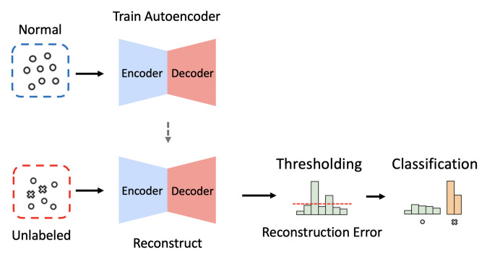
Anomaly Detection with autoencoders

Slide 25
Anomaly Detection with autoencoders
Example of implementation of autoencoders in Python
https://colab.research.google.com/drive/1g8b2C4Wk1eJE7GsGEcdoWC8_afVRr-X0?usp=sharing
Dataset:
KDDCUP 1999 dataset, which contains an extensive amount of data representing a wide range of intrusion attacks.
https://kdd.ics.uci.edu/databases/kddcup99/kddcup99.html
We will narrow the scope to only data related to HTTP attacks

Slide 26
References
Alla, S., & Adari, S. K. (2019). Beginning anomaly detection using python-based deep learning. New Jersey: Apress.
Rajvardhan Oak. (2023).10 Machine Learning Blueprints You Should Know for Cybersecurity: Protect your systems and boost your defenses with cutting-edge AI techniques. Packt Publishing.

Slide 27

Thank you
Please send all questions to:
dboberic@uns.ac.rs

